Slide 1
Jin Lee
SWENG 837 Software System Design
Final Project
August 2024

Slide 2
Project Details
Healthcare Software Engineering: This field is gaining prominence with substantial investments to enhance software quality in healthcare. The primary goals include improving employee efficiency, enhancing patient experiences, and streamlining medical care delivery.
Potential Systems:
Unified Patient Manager: Centralized access to patient data with stringent security measures.
MediFind: An easily accessible medicine database offering comprehensive drug descriptions via QR codes.
Qalb+: A platform facilitating the search for nearby healthcare providers and doctors, considering specialties and accepted insurance types.
KLIK: A web application fostering community engagement and alleviating loneliness among patient communities by creating support groups.

Slide 3
Business statement
The Unified Service Provider system will be a customer-facing platform that integrates the following services: Unified Patient Manager, MediFind, Qalb+, KLIK, and Billing & Scheduling Services. The system is designed to simplify and streamline processes for both patients and medical providers, ensuring the delivery of high-quality health care.

Slide 4
System Requirements
The system shall provide a centralized database for patient data
The Unified Patient Manger subsystem shall allow user to view, update, and manage patient records
The system shall provide a medical database for drug descriptions
The MediFind subsystem shall enable searches using QR codes.
The MediFind subsystem shall analysis all of the users’ prescriptions for known complications
The MediFind subsystem shall notify users when a drug complication is detected
The system shall provide a database of healthcare providers
The Qalb+ subsystem shall allow user to search for providers based on user preferences
The Qalb+ subsystem shall display the types of accepted insurances by each healthcare provider
The system shall provide a database of support communities
The KLIK subsystem shall allow user to search for support communities based on user preferences
The system shall provide a billing system service
The Billing subsystem shall provide various payment methods.
The Billing subsystem shall automate pricing based on insurance policies
The system shall allow patients to schedule appointments with their medical providers
The system shall be able to be access on multiple platforms and devices

Slide 5
Non-Functional Requirements (1 of 2)
Performance
The system shall respond to user queries within 5 seconds
The system shall provide search results within 10 seconds of a query
The system shall load user’s patients records within 5 seconds
The system shall allow up to 1,000 simultaneous users
The system shall limit the number of user to simultaneous access a single patients records to 5 users.
Security
The system shall implement multifactor authentication
The system shall implement strict security process to protect all data
The system shall implement role base access controls.
Usability
All search functions shall be customizable
All search results shall allow customizable filters
The systems UI shall be intuitive and user friendly.

Slide 6
Non-Functional Requirements (2 of 2)
Reliability
The system shall be able to synchronize data from multiple sources
The system shall be able to aggregate data from multiple source
Scalability
The system shall be designed to allow scalability for future growth.
The system shall be designed to handle a sudden influx of users.
The system shall be able to integrate with existing healthcare systems

Slide 7
Use Case Analysis – Primary Actors
Type | Actor | Goal Description
Primary | Patient | Receive top quality healthcare to improve quality of life. Access personal healthcare records Schedule appointments Communicate with healthcare providers View test results Manage health related tasks. Access support groups
Primary | Doctor | Provide top quality healthcare coverage by accurate diagnoses and provide treatment to patients. Access patient health records Document medical notes Prescribe medications Order tests Review test results Communicate with patients Manage patient appointments.
Primary | Nurses | Provide top quality healthcare coverage by support doctors and administrating doctors Access patient health records Take and record patient vitals Update patient medications Administrate care

Slide 8
Use Case Analysis – Supporting Actors
Type | Actor | Goal Description
Supporting | Pharmacists | Provide medication and counseling to patients. Access electronic prescriptions Dispense medication Verify drug interactions Provide counseling on medication Alert patient when prescriptions are ready for pickup
Supporting | Lab Technicians | Conduct, analyze, and record medical test results. Receive test orders Administer tests Record test results.
Supporting | Insurance Companies | Provide medical coverage for patients Provide policy coverage details Provide billing guidance

Slide 9
Use Case Analysis – Offstage Actors
Type | Actor | Goal Description
Offstage | U.S. Department of Health and Human Services (HHS) | The HHS will require that all federal regulations such as the Health Insurance Portability and Accountability Act (HIPPA) are met.
Offstage | Medical Coders | Review and assign standard codes based on medical services received and insurance for billing.
Offstage | Pharmaceutical companies and research labs | Receive the lasted news on medical technologies and enhancements. Receive updates on New approved drugs Process and procedures Clinical trials

Slide 10
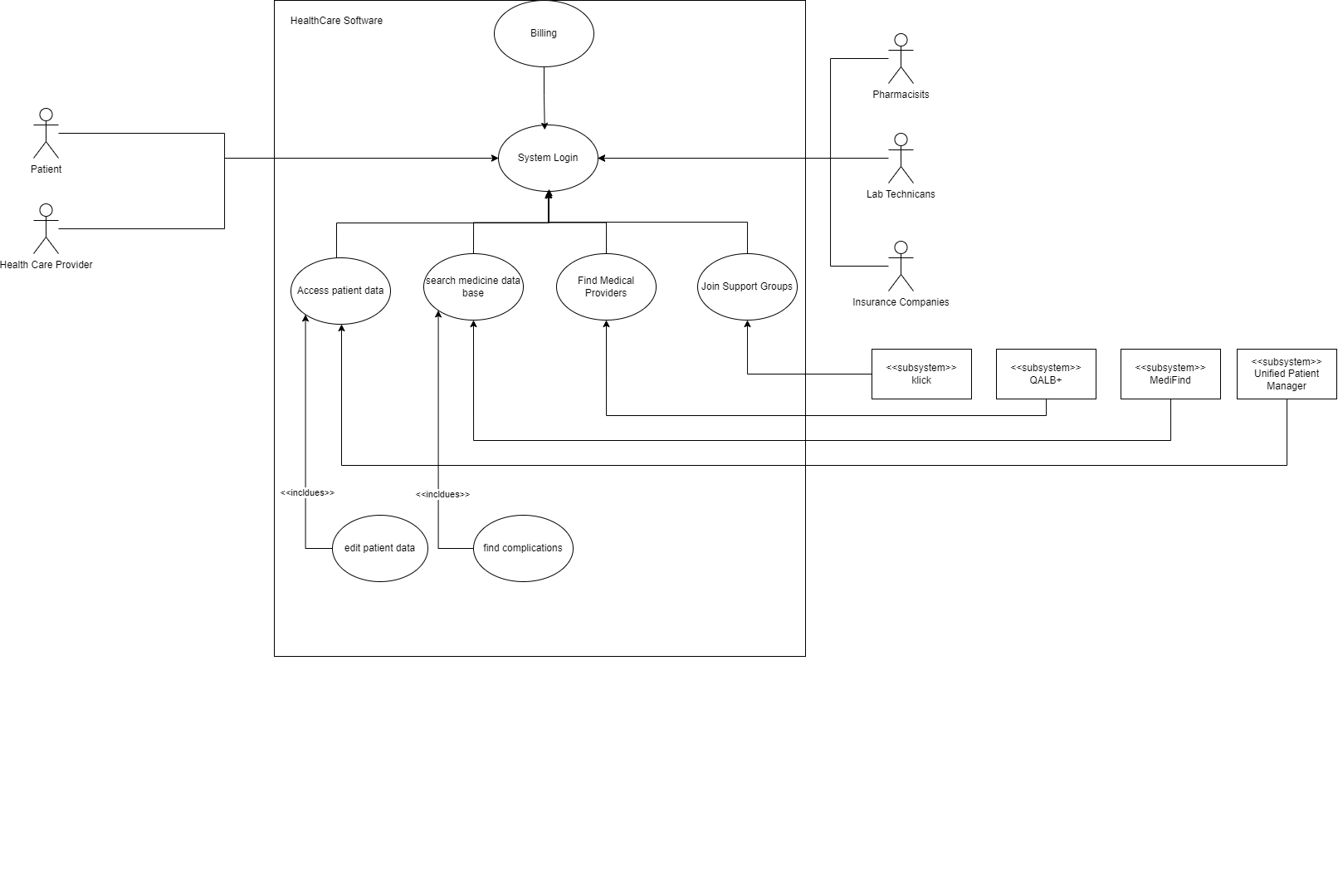
High Level – Overall Use Case Diagram
High Level System Use case diagram showing primary actors, support actors, and subsystems

Slide 11
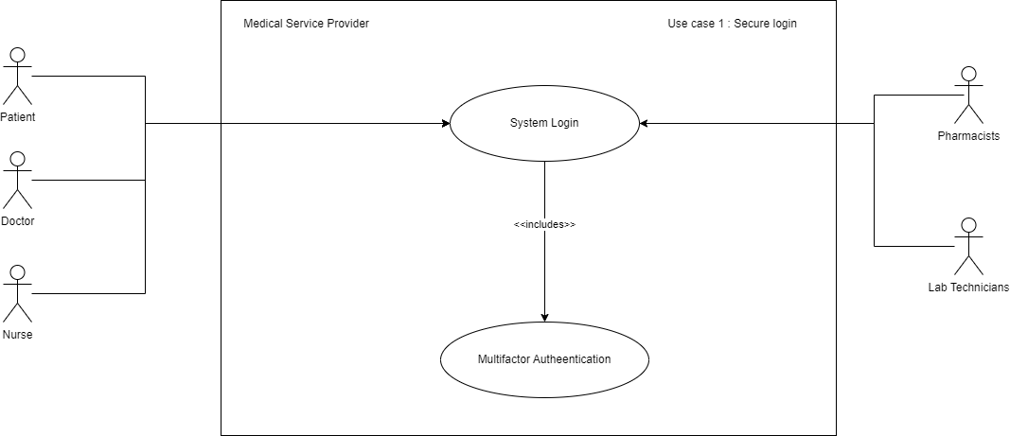
Use Case 1 – Secure Login
Use Case Specification | Description
Use Case Name | Secure login
Scope | Overall system, Security
Level | User Goal
Primary Actor | Patient, Medical Provider (Doctors, Nurses)
Stake holders and interests | Ensures that only authorized uses can access personal/medical information
Pre-conditions | User must create a valid account. User must have multifactor authentication enabled.
Success Guarantee | User uses multifactor authentication to access the system
Main Success scenario | Patient logs into system using username & password System validates patient’s login credentials System activates multifactor authentication Multifactor authentication sends patient unique pin Patient enters unique pin Multifactor validates unique pin and sends confirmation to system System receives authentication and allows user access to system.
Extensions | User inputs the wrong username and password combination User forgets password User does not receive multifactor authenticator pin

Slide 12
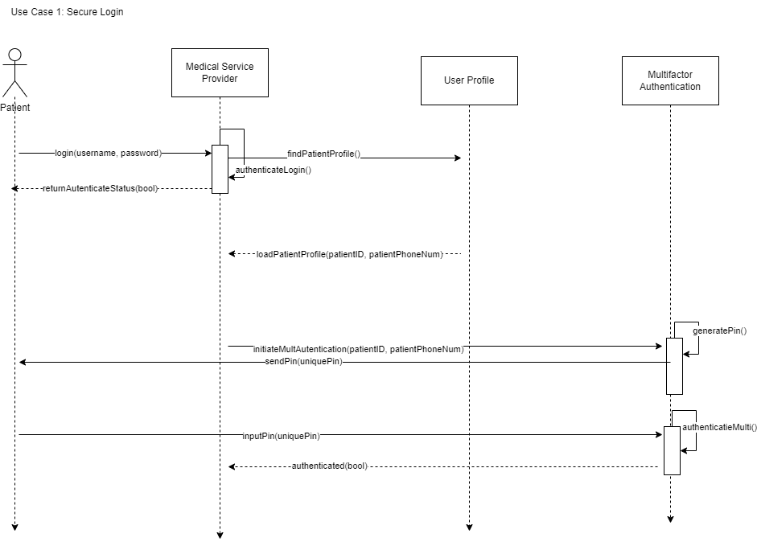
Use Case 1 – Secure Login
User enters username and password
System authentication login against user profile
System load user profile and initiates multifactor authentication
Multifactor authentication authenticates user and allows access to the system

Slide 13
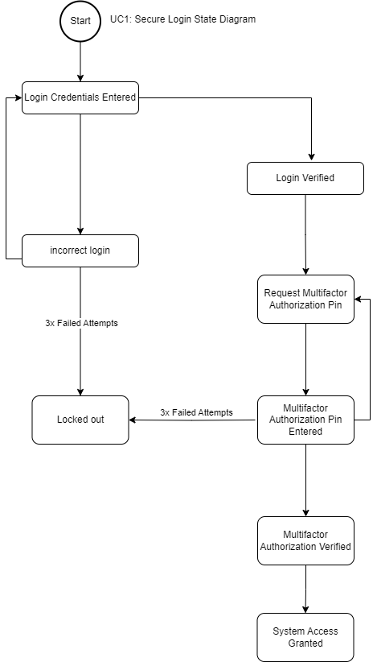
Use Case 1 – Secure Login

Slide 14
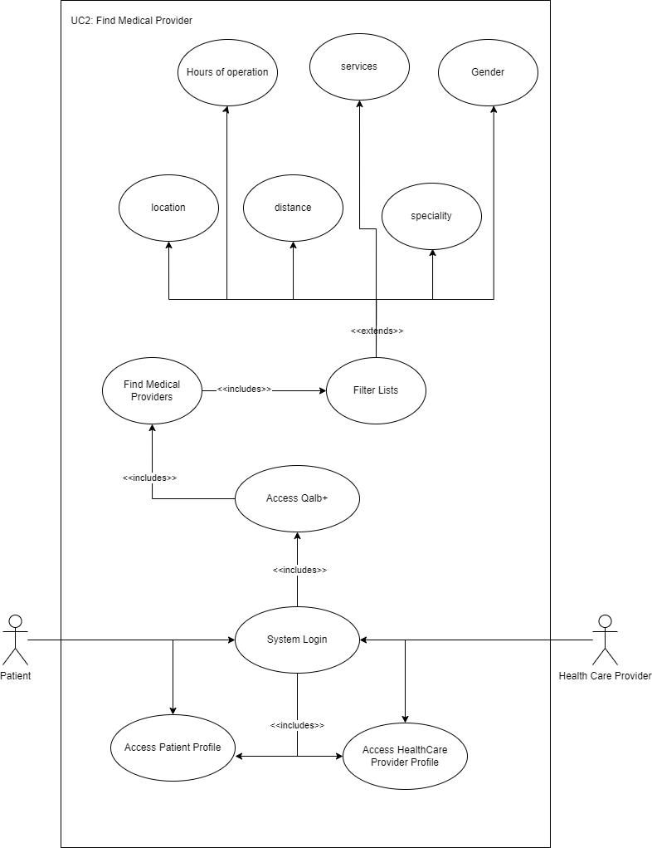
Use Case 2 – Find Medical Provider
Use Case Specification | Description
Use Case Name | Find Medical Provider
Scope | Qalb+: A platform facilitating the search for nearby healthcare providers and doctors, considering specialties and accepted insurance types.
Level | User Goal
Primary Actor | Patient
Stake holders and interests | Doctors: Update the profiles so that patients can find them by availability, location, hours of operation, specialty, accepted insurance, experience, etc.
Pre-conditions | Patient has completed login process and now has access to the system
Success Guarantee | Patient is able to find a medical provider based on their preferences
Main Success scenario | Patient is able to search for all medical providers by location Patient is able to refined search results with their preferences Patient is able to select a medical provider and view more detailed information
Extensions | Medical Provider profile is not up to date Medical Provider does not have a profile in the database

Slide 15
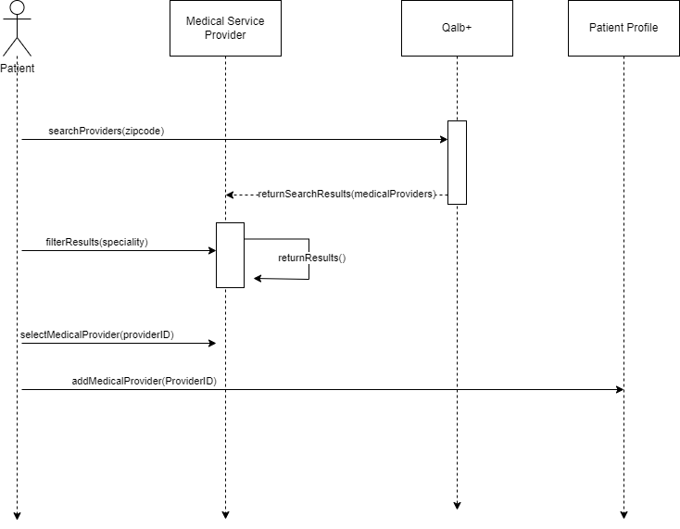
Use Case 2 – Find Medical Provider
User initiate search for medical providers based on location
User refines search results with filters
User selects a medical provider and adds them to their list of Medical Providers

Slide 16
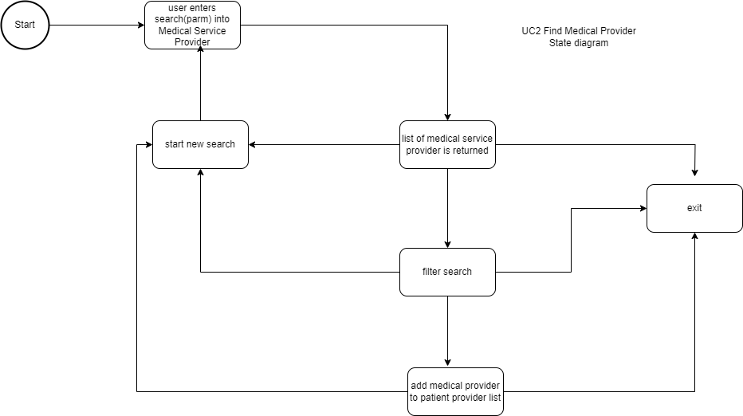
Use Case 2 – Find Medical Provider

Slide 17
Use Case 3 – Prescribe Medication
Use Case Specification | Description
Use Case Name | Prescribe Medication
Scope | MediFind: An easily accessible medicine database offering comprehensive drug descriptions via QR codes.
Level | User goal
Primary Actor | Doctor
Stake holders and interests | Patient: Patient relieves the proper medication for treatment Pharmacy: Pharmacy receives the prescription to fill for patient Insurance Company: Approves and provides billing information
Pre-conditions | Patient has preferred pharmacy on file Doctor has completed login to the system and has access to patient medical records.
Success Guarantee | Doctor writes prescription into patient prescription lists. Prescription is sent to pharmacy on file in patients records.
Main Success scenario | Doctor adds new prescription to patients’ prescription lists MediFind notifies doctor that there are no known complications with current medications Prescription is electronically sent to pharmacy on file
Extensions | A complication was found in MediFind

Slide 18
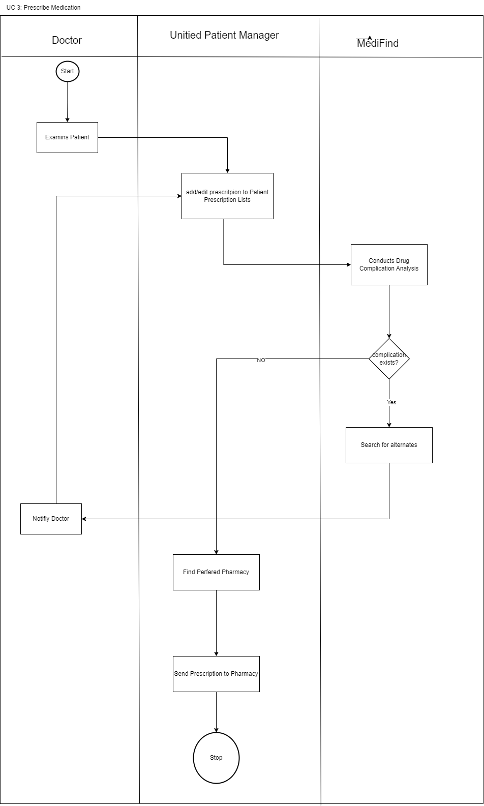
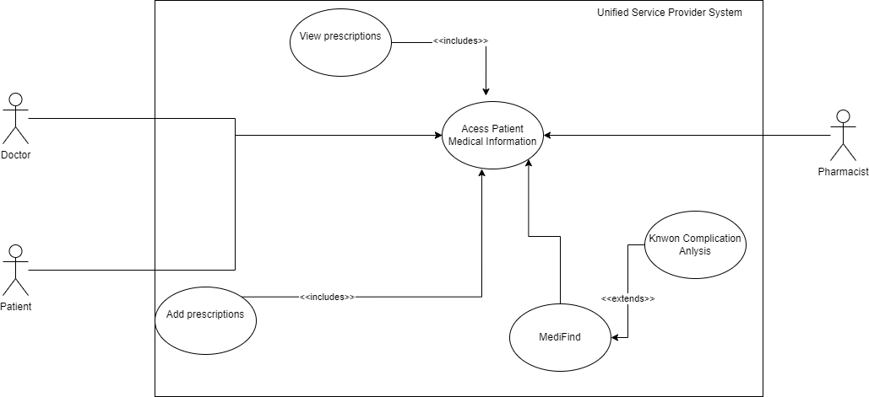
Use Case 3 – Prescribe Medication

Slide 19
Use Case 4 – Schedule Medical Appointments
Use Case Specification | Description
Use Case Name | Schedule Medical appointments
Scope | Scheduler
Level | User goal
Primary Actor | Patient
Stake holders and interests | Doctors, Labs. So, they can allocate sufficient time to administer proper care.
Pre-conditions | Patient must have valid account. Patient must have primary physician, specialists, pharmacy, and insurance information on file. Patient completes to login process
Success Guarantee | Patient arrives at medical provider on time and is able to see provider within 30 minutes of appointment time.
Main Success scenario | System loads all of patient’s medical providers Patient selects a medical provider and access their calendar Patient request an appointment at request time and date System sends request to medical provider Medical provider accepts appointment request
Extensions | Medical Provider has no availability on their calendar Medical provider rejects appointment request Patient wants to cancel or reschedule an appointment
Use Case Specification | Description
Use Case Name | Prescribe tests
Scope | Scheduler
Level | User goal
Primary Actor | Patient
Stake holders and interests | Doctors, Labs. So, they can allocate sufficient time to administer proper care.
Pre-conditions | Patient must have valid account. Patient must have primary physician, specialists, pharmacy, and insurance information on file. Patient completes to login process
Success Guarantee | Patient arrives at medical provider on time and is able to see provider within 30 minutes of appointment time.
Main Success scenario | System loads all of patient’s medical providers Patient selects a medical provider and access their calendar Patient request an appointment at request time and date System sends request to medical provider Medical provider accepts appointment request
Extensions | Medical Provider has no availability on their calendar Medical provider rejects appointment request Patient wants to cancel or reschedule an appointment
Analysis of this use case revealed the need for a scheduler

Slide 20
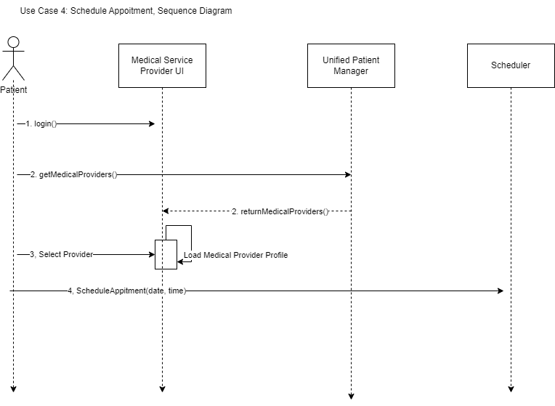
Use Case 4 – Schedule Medical Appointments
Patient logs into system using secure login in process
Patient pulls up the medical providers lists
Patient selects the medical providers profile and selects the request appointment button

Slide 21
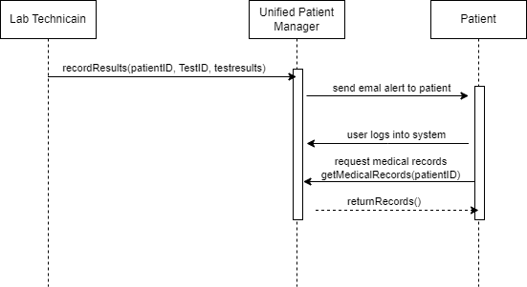
Use Case 5 – View Test Results
Use Case Specification | Description
Use Case Name | View Test Results
Scope | Unified Patient Manager: Centralized access to patient data with stringent security measures.
Level | User goal
Primary Actor | Patient
Stake holders and interests | Doctor: Doctor is able to view test results and provide comprehensive follow up care
Pre-conditions | Patient has completed the required test. Lab Technician/Medical Provider has logged into the system. Lab Technician/Medical Provider are authorized to view/edit patients’ medical information
Success Guarantee | Patient is able to view test results.
Main Success scenario | Lab Technican/Medical Provider enters test results into patients’ medical history System sends a notification to patient and primary physician that test results are available. Patient logs into the system Patient access medical history and views test results
Extensions | Medical provider does not have access rights to patient records

Slide 22
Use Case 6 – Join Support Group
Use Case Specification | Description
Use Case Name | Join Support Group
Scope | KLIK: A web application fostering community engagement and alleviating loneliness among patient communities by creating support groups.
Level | User goal
Primary Actor | Patient
Stake holders and interests | Patient medical providers and family: Wants to ensure that patient has support tools and resources for physical and mental health issues
Pre-conditions | Patient must be logged into the system Support group of interest is available
Success Guarantee | Patient is able to join selected support group
Main Success scenario | Patient searches for support group in KLIK Patient is able to filter through search results Patient is able to select and join desired support group
Extensions | Database is offline Support group of interest does not exist.

Slide 23
Domain Model
Conceptual Class Category | Example of Medical Service Provider (MSP)
Physical or Tangible Objects | Computer, Input Device, Display
Specifications, Designs or Descriptions of Things | Patient Information, Insurance Plans, Medical Service Providers, User Profile, Unified Patient Manager, Qalb+, MediFind, KLIK
Places | Proximity to patient, Clinic, waiting room, pharmacy
Transactions | Find Medical Provider, insurance claims, discharge
Transaction Line Items | Insurance Plan, zip code, Medical Services
Roles of People | Patient, Provider, Pharmacy, Lab Technician
Containers of Other Things | Patient Information, Insurance Plan, Medical Service Provider, Prescription List, patient folders
Things in a Container | Age, Sex, Name, Hours of Operation, Address, Drug Name, Prescriptions
Other Computers/Systems (external) | Databases
Abstract Noun Concepts | Authenticate, Security,
Organizations | Hospitals, Insurance Providers
Events | Find health care provider, find support group, get drug information
Processes | Update information, find healthcare provider, find social groups
Rules and polices | HIPPA, cyber security
Catalogs | Insurance Options, Healthcare options
Record of Finance, Work, Contracts, Legal Matters, etc, | Billing, Medical Records,
Financial Instruments and Services | Insurance Rates
Manuals, Books, Documents, Reference Paper | Drug Descriptions
Good | Bad
User Profile | Computer, input device, display, proximity to patient, clinic, waiting room, pharmacy, find medical provider, insurance plan, zip code, discharge, insurance claims, age, sex, name, address, drug name, Databases, patient folders, healthcare options, drug descriptions
Patient Profile
Insurance Plan
Medical Provider
Billing
Hours of Operation
Qalb+
MediFind
KLIK
Unified Patient Manger
Prescription
Multifactor Authentication
Medical Service Provider

Slide 24
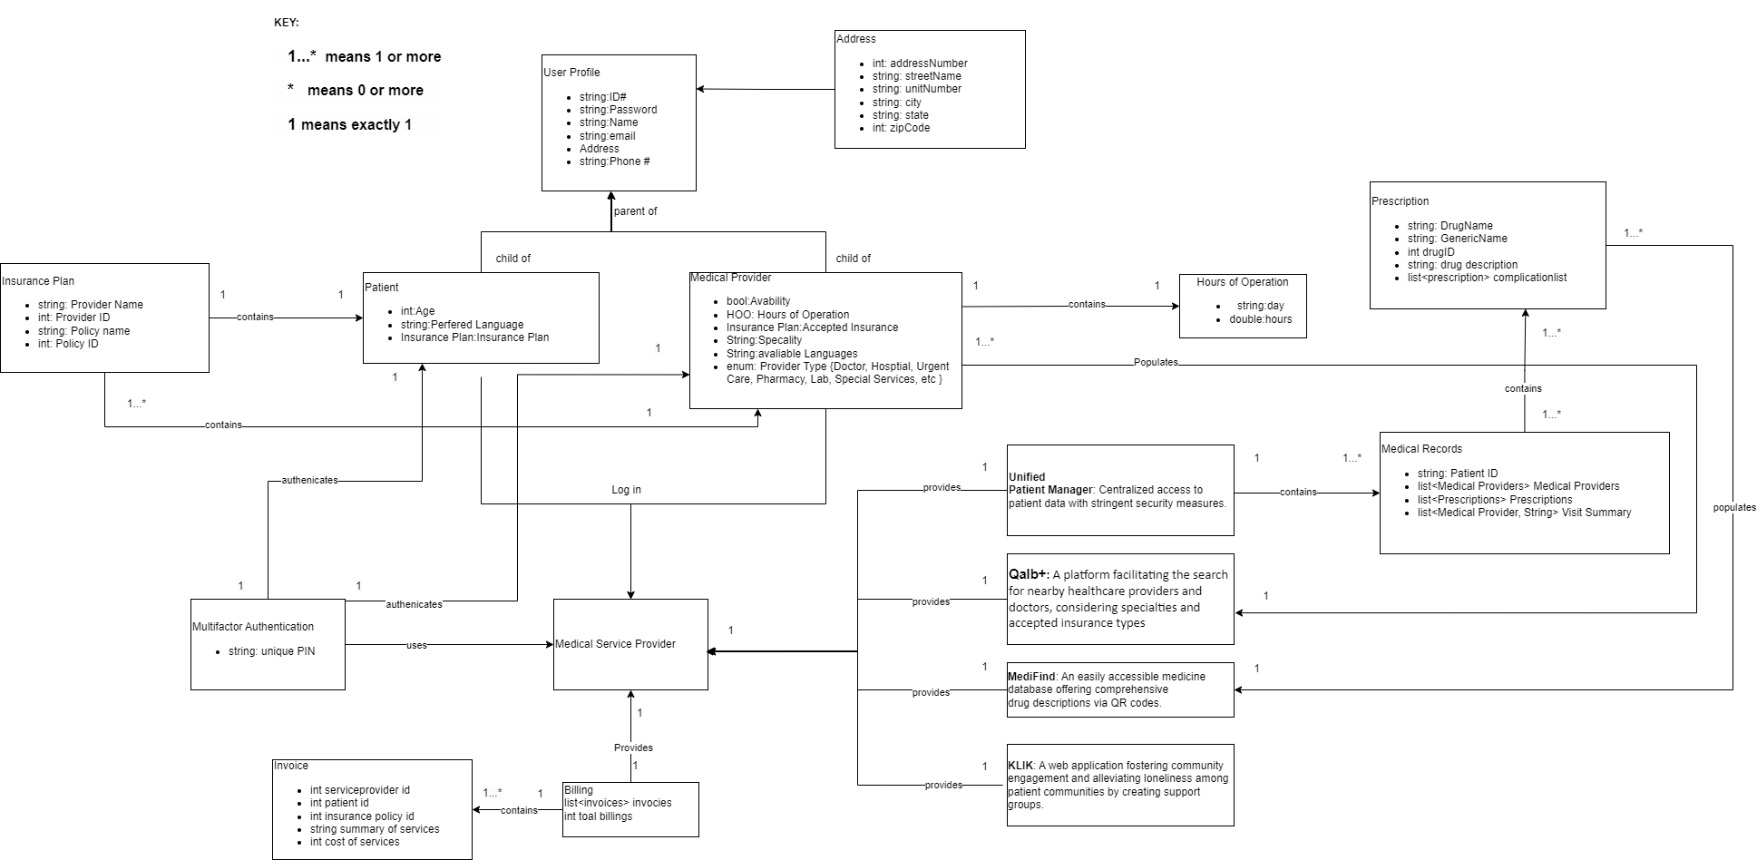
Domain Model

Slide 25
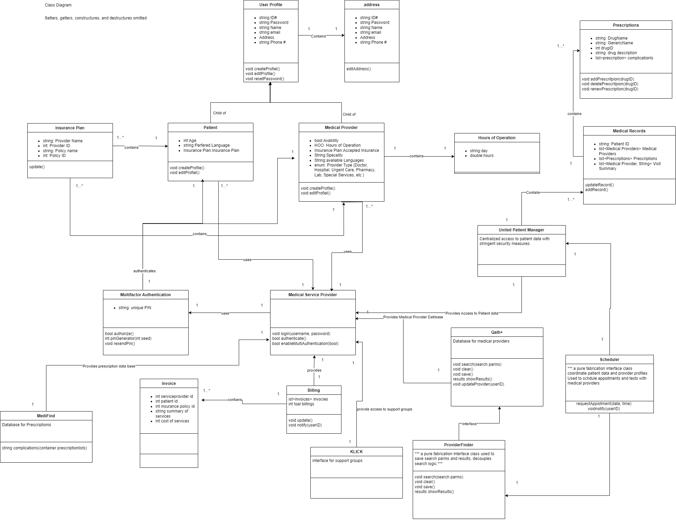
Class Diagram

Slide 26
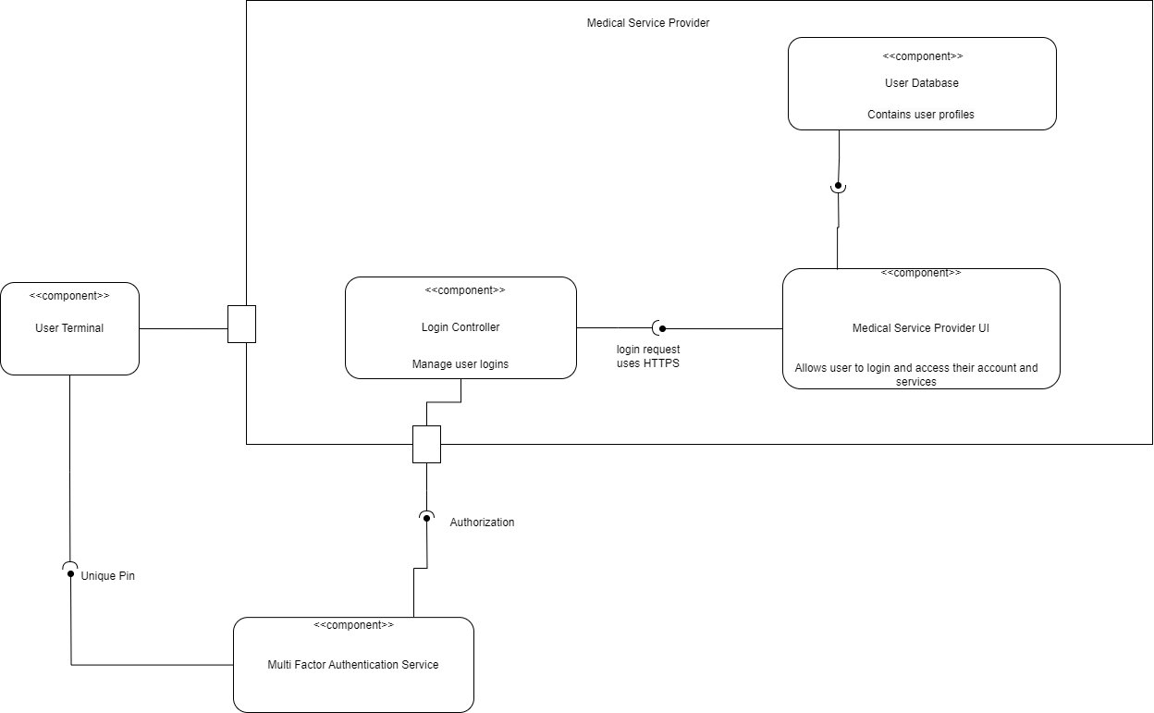
Component Diagram

Slide 27
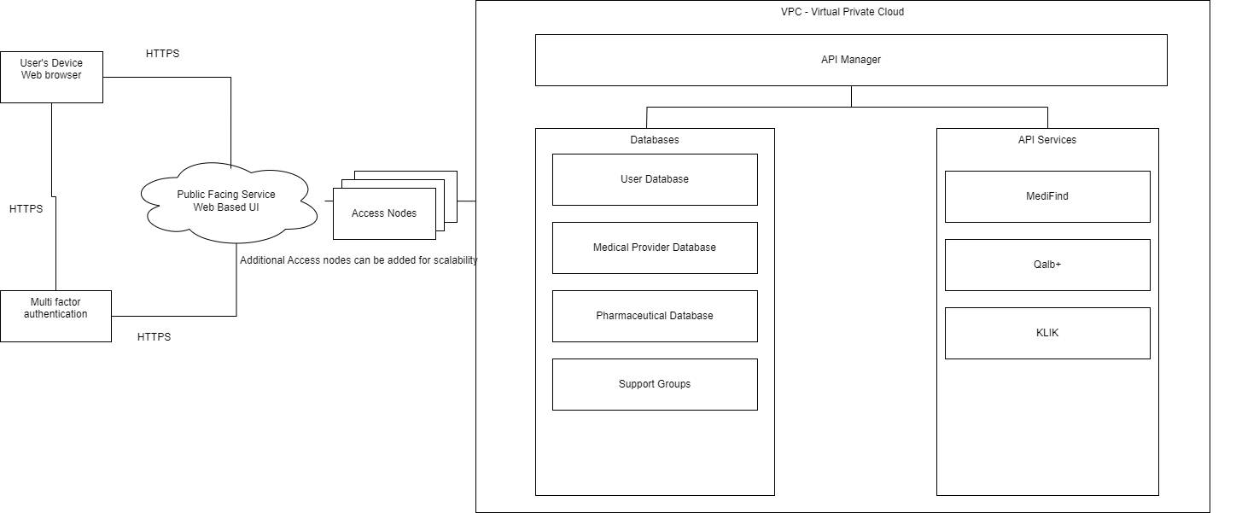
Deployment Diagram

Slide 28
Design Principles & Patterns
General Responsibility Assignment Software Patterns
Polymorphism & inheritance used when possible for to reduce code redundancy
Example: Parent Class User Profile, Child Classes: Patient Profile & Medical Provider Profile
Pure Fabrication: Introduced Pure Fabrication class to decouple capabilities that require collaboration from multiple databases
SOLID
Single responsibility Principle, Tried to design classes that focused on a single thing

Slide 29
Databases
The Unified Service Provider system contains 5 Databases
Authentication Credentials | Contains User’s login credentials
Unified Patient Manager | Patient Data
MediFind | Drug Data
Qalb+ | Medical Providers Data
KLIK | Support Groups
The Unified Service Provider is a cloud base system and will utilize the Microservices architecture. The microservices pattern allows each data base to be managed separately.

Slide 30
Conclusions
The goal of the design of the Unified Service Provider system is to use proved existing technologies to reduce the complexity of this system. The built in security features of google authenticator and AWS services greatly reduced the complexity and development time. Following the Keep it simple methodology, each class was design to do 1 thing.
Lessons Learned: The used of class diagram and design principles will help me simplify and plan out future software projects. The introduction of the domain model was a new concept that I found helpful to shape the scope of this project.
In additional to lessons learned, I would like to dive deeper in the AWS cloud service and infrastructure to the a better understanding of AWS.
Links:
Github: https://github.com/jleePennState/SWENG837/tree/main
YouTube Presentation Part 1: https://youtu.be/J-43xnPC8oQ
YouTube Presentation Part 2: https://youtu.be/ZB3gyImuqOU

